Slide 1
Automatic Toll Tax systems have really helped a lot in reducing the heavy congestion caused in the National Highways of today. It is one of the easiest methods used to organize the heavy flow of traffic.
When the car moves through the toll gate on any road, it is indicated on the RFID reader that it has crossed the clearing. The need for manual toll based systems is completely reduced in this methods and the tolling transaction system works through RFID. The system thus installed is quite expedient reducing the time and cost of travelers since the RFID tag can be deciphered from a distance.
ABSTRACT

Slide 2
ATGS system is that it is capable of eliminate congestion in toll plaza, especially during those seasons when traffic seems to be higher than normal.
The Benefits of this System are:
* Shorter queues at toll plazas by increasing toll booth service speed.
* Faster and more efficient service through technology
*The ability to make payments by keeping a balance on the card itself and
*The use of postpaid toll statements
* Other general advantages include minimization of fuel wastage and reduced harmful emissions.
For Toll Operators, the benefits include:
$ Lowered toll collection costs
$ Better audit control by centralized user account
BENEFITS

Slide 3
This project gives the simplified procedure to passengers to pay toll at toll booths by making them automated, and for vehicle theft detection. All these activities are carried using single RFID tag thus saving the efforts of carrying money and records manually.
Automatic Toll Collection: The RFID Readers mounted at toll booth will read the prepaid RFID tags fixed on vehicles’ windshield and automatically respective amount will be deducted. If the tag is removed from the windshield then cameras fixed at two sites at toll plaza take snaps of the front and back number plate. Since every vehicle registration ID is linked to users account, toll can be deducted from the account bank directly.
Vehicle Theft Detection: When vehicle is stolen the owner registers complaint on the website with its registration ID and unique RFID tag number. Now when stolen vehicle passes by the toll plaza, the tag fixed on it is matched with the stolen vehicle's tag in the database at the toll booth.
PROPOSED SYSTEM

Slide 4
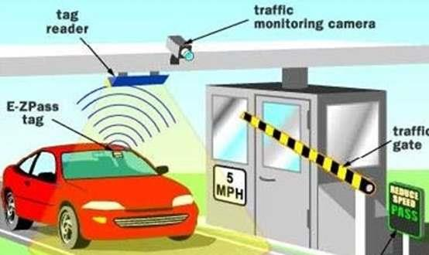
The System of RFID toll tax

Slide 5
4+1 Views of the software
4+1 is a view model designed by Philippe Kruchten for "describing the architecture of software-intensive systems, based on the use of multiple, concurrent views". The views are used to describe the system from the viewpoint of different stakeholders, such as end-users, developers, system engineer, and project managers. The four views of the model are logical, development, process and physical view. In addition selected use case or scenarios are used to illustrate the architecture serving as the 'plus one' view.

Slide 6
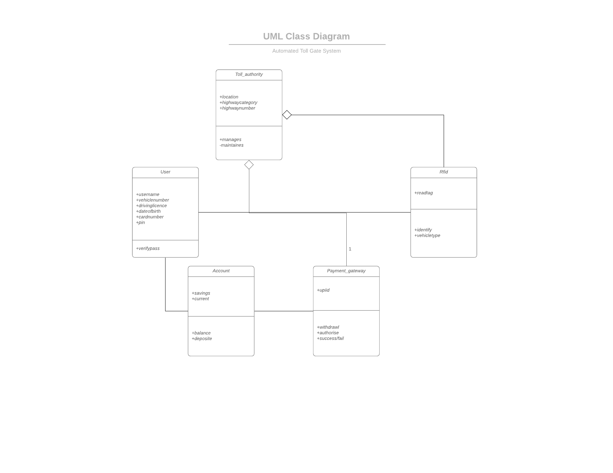
Logical View

Slide 7
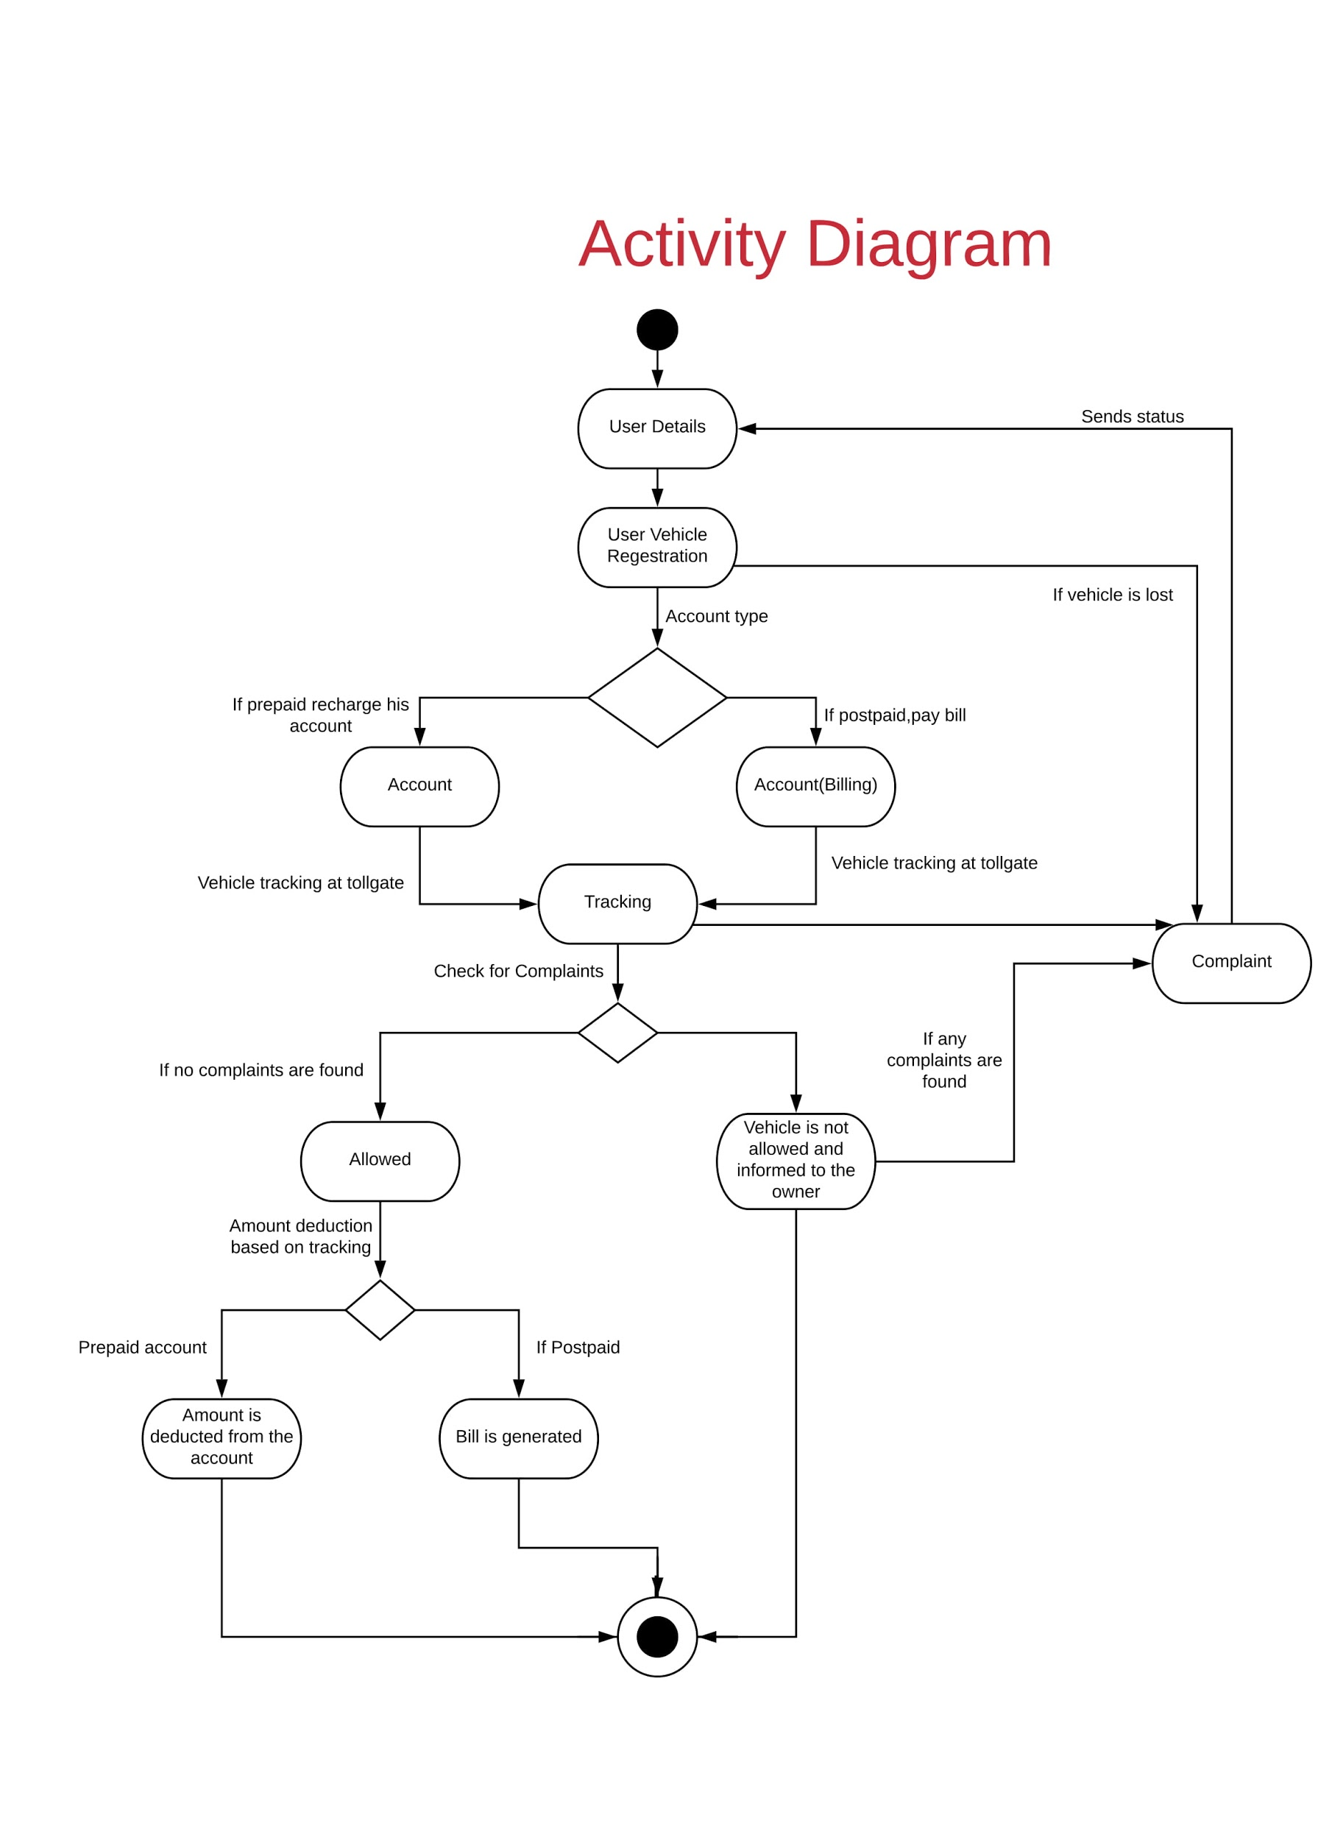
Process View

Slide 8
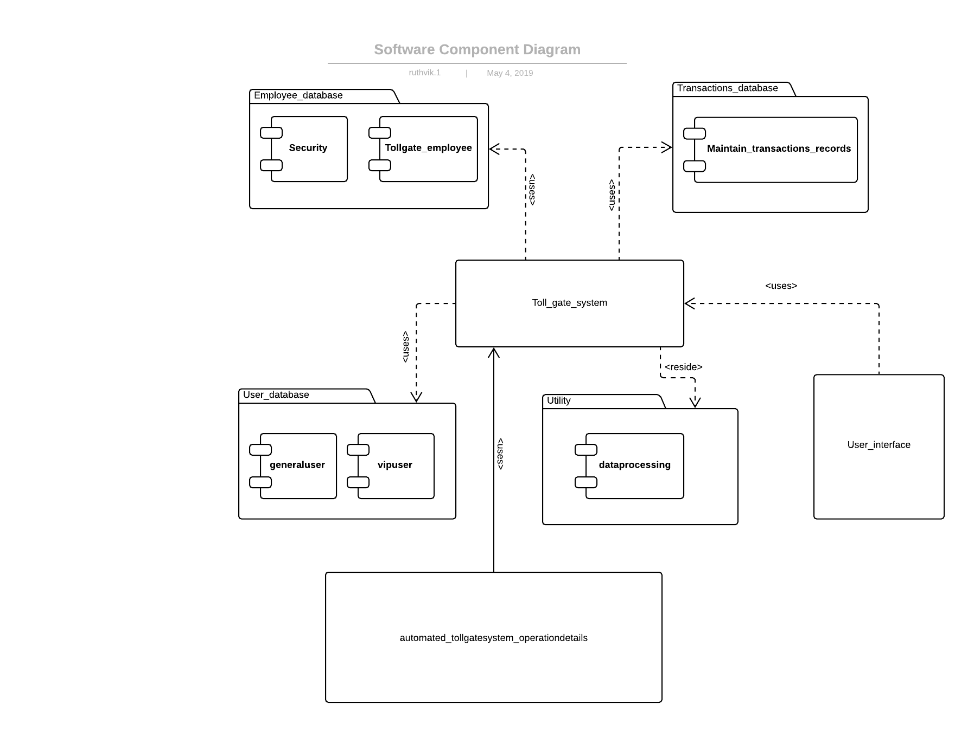
Development View

Slide 9
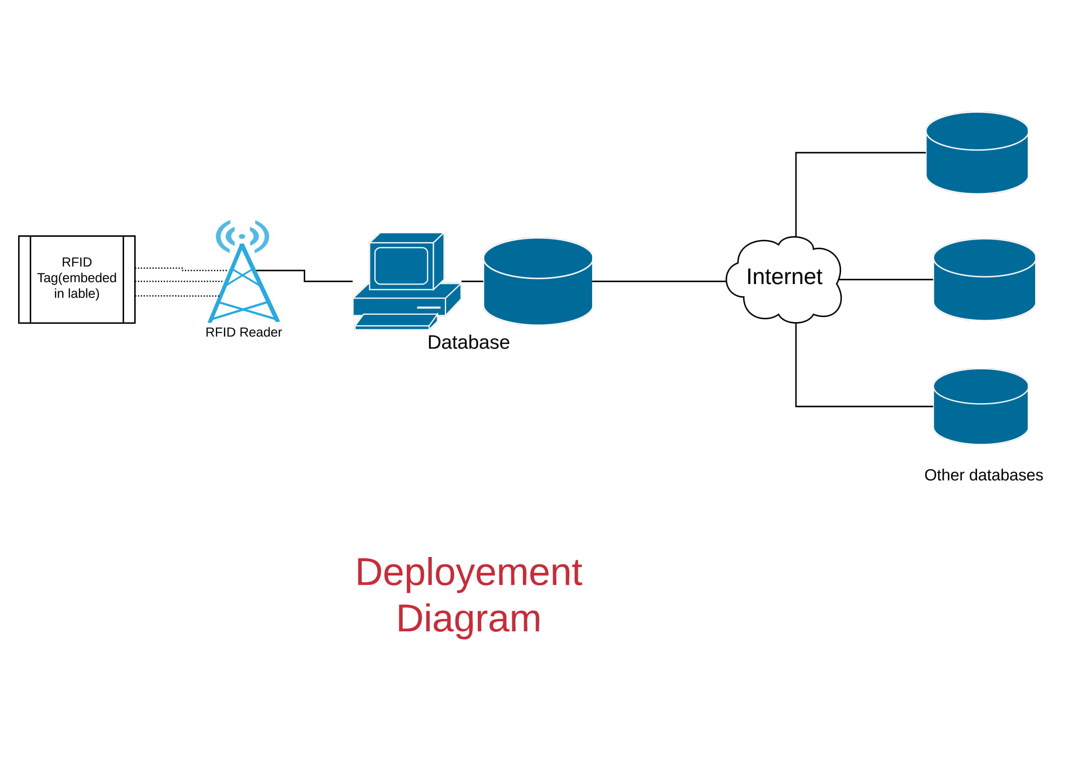
Physical View

Slide 10
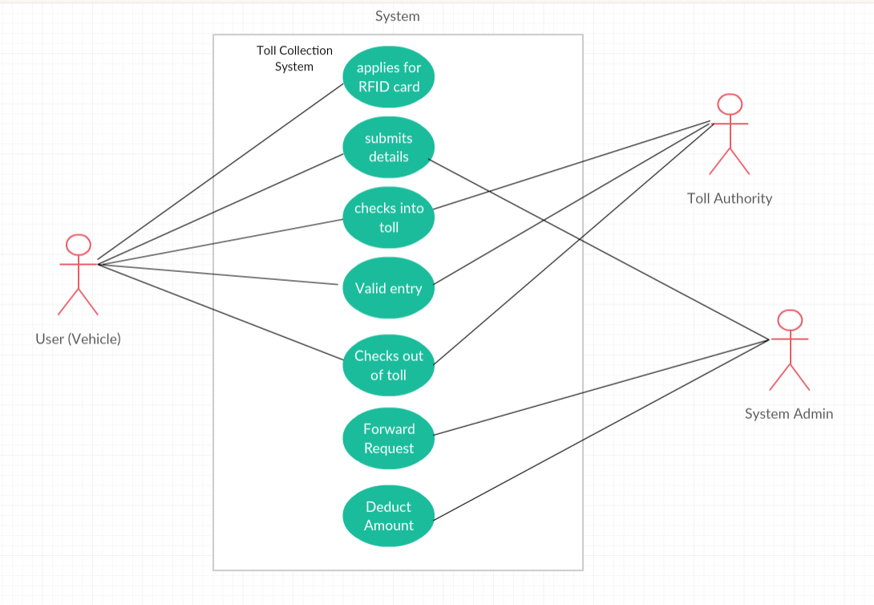
Use Case or Scenario

Slide 11
We believe that every project needs to be handled differently and the existing methods need to be tailored to best suit the project requirements.
In Agile model, the tasks are divided to time boxes
(small time frames) to deliver specific features, and helps
in changing requirement for customers.
So we choose to use agile development model mainly scrum method for our software engineering project for the best possible development of the project in the given time frame.
SDLC model

Slide 12
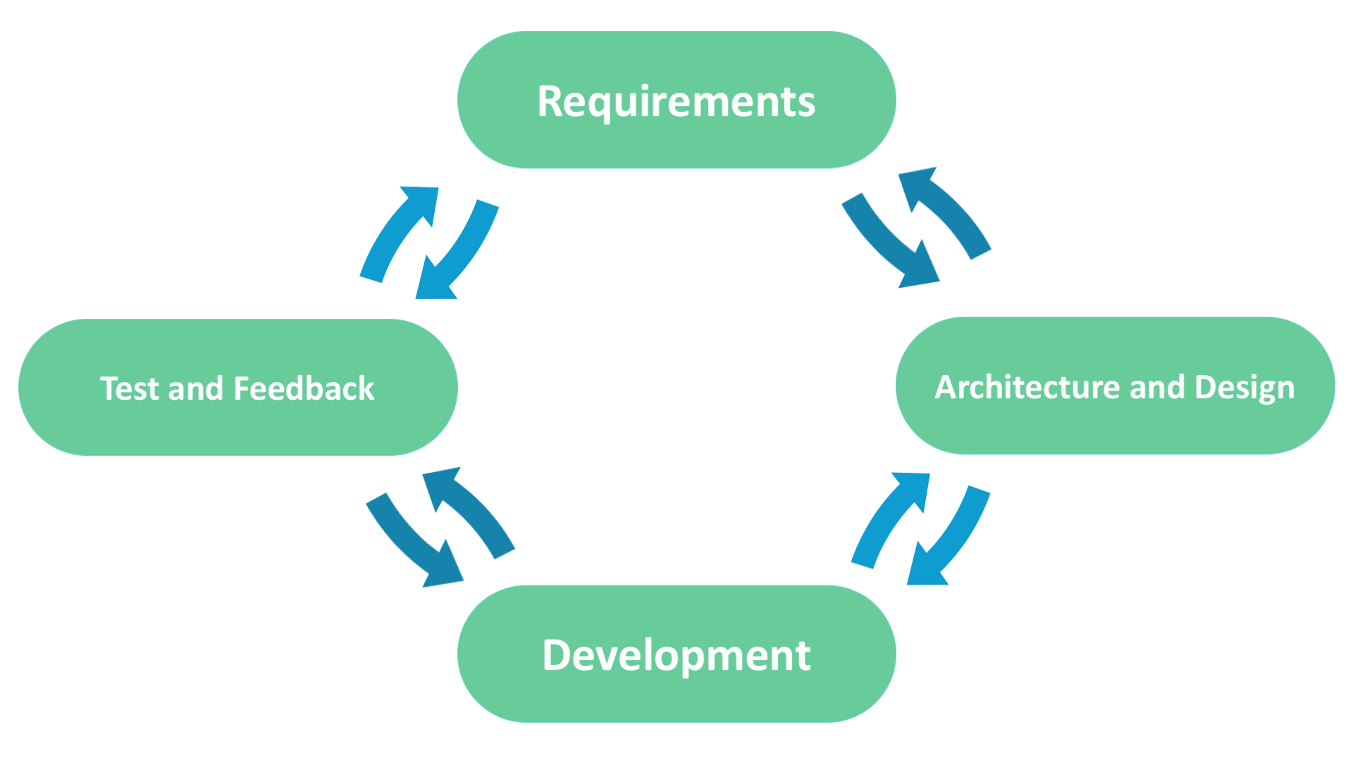
Software Development life cycle

Slide 13
REQUIREMENTS
To provide the user/customer a platform to make Toll-gate system easy and convenient.
Customer/user should get to register his account and use it along tolls passing.
Need of updating his profile.
Report the stolen car.
Forgetting the password is common, so flexibility to change the password.
Linking with mail for giving details to customer by the firm/developer.
Security towards his profile as personal information is present.
Trusted banking transactions for the toll.

Slide 14
ARCHITECTURE AND DESIGN
Django web framework and HTML and CSS technology to build website
Coding in Python language.
Web page provides the customer to register and registered user to login.
User can look upon and update his profile.
User gets notifications on his vehicle passing tollgate and deduction of money.
User gets mail reply for his request of ‘forgot password’.

Slide 15
DEVELOPMENT
Further this project can be linked with standard and trusted banking platform for the real time use of project.
Queries and complaints can also be added on by the users.
User experience and performance of the website can be increased to meet the continuous changing needs.
Banking transaction method and account maintenance also can be developed with in the project for more security and credibility of website.
As the main problem comes in means and modes of payment, different payment schemes can be included.

Slide 16
TEST AND FEEDBACK
Project after completion is tested by us and our friends as new customer and registered users.
The account balance was updated successfully.
We were successfully able to block the vehicle from passing through the tollgate in case the vehicle gets stolen as the owner declares it for the safety reasons we also send the email to concerned authority and police for proper safety and further guidance.

